Slide 1
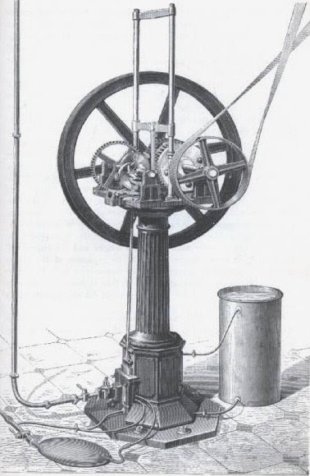
Otto and Langen
Chapter 8

Slide 2
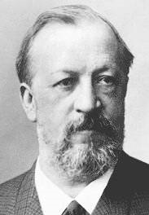
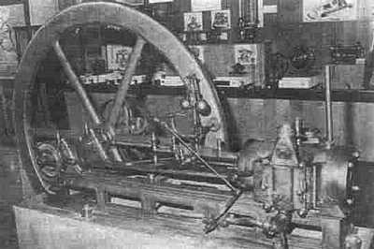
Nicolaus August Otto, 1832-1891
Born in Holzhausen, Taunus.
Left high-school, worked in grocery store. Salesman of tea, sugar and kitchenware.
1861: Rejected patent for an alcoholic-air carburetor.
1861-1863: Experimented and tried to improve Lenoir engine.
1863: Atmospheric engine with free-piston built by Michael Zons.

Slide 3
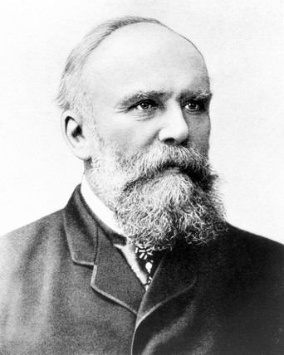
Eugen Langen, 1833-1895
Born in Cologne.
Karlsruhe Polytechnikum, but no graduation.
Worked in the family sugar enterprise.
Entrepreneur; founded a coal grate company.
1864: Met Otto and founded N.A. Otto & Company.

Slide 4
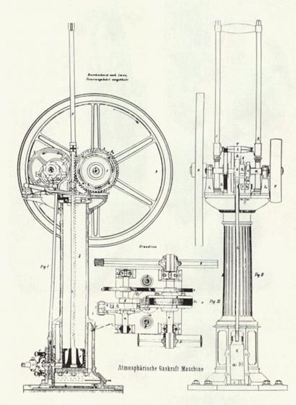
N.A. Otto & Company
Otto, inventor.
Langen, engineer and businessman.
First company to manufacture IC-engines.
Improved Otto’s first engine.
1867: Otto and Langen engine demonstration at Paris Exposition. Big success!

Slide 5

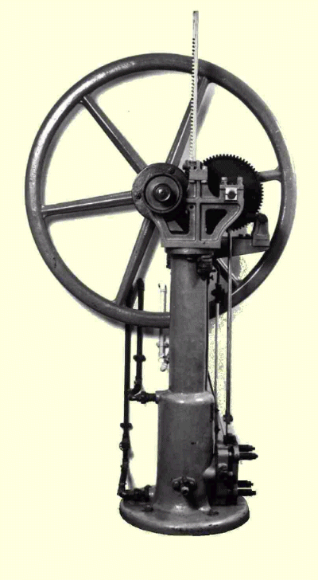
Gasmotoren-Fabrik Deutz AG
Paris Exposition success required business expansion.
1869: Langen, Otto and Roosen. Ludvig August Roosen-Runge became limited partner. Facilities moved to Deutz.
1872: Gasmotoren-Fabrik Deutz AG. Otto , technical director with no ownership. Langen, owner and CEO.
Rapid growth required enhanced factory management skills.

Slide 6
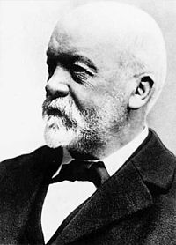
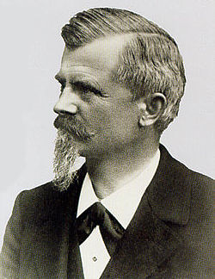
Gottlieb Daimler, 1834 - 1900
Engineering graduate from Stuttgart Polytechnikum, specialised in manufacturing.
Experience man; gunsmith, locomotives, Paris, England.
1872: Joined Gasmotoren-Fabrik Deutz AG as production manager.
Brought Wilhelm Maybach, head of design department.

Slide 7
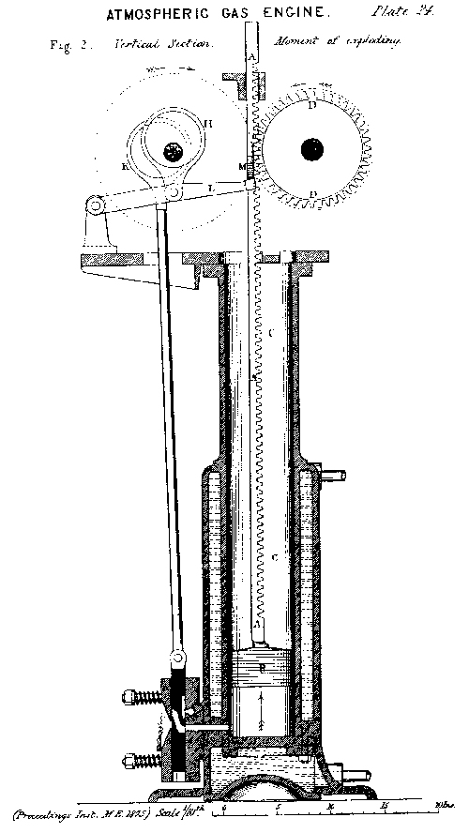
The Otto and Langen Engine
Atmospheric and non-compression engine, run on gas.
Intake and ignition through sliding valve.
Combustion sends piston ”rocket-like” beyond expansion.
Resultning negative pressure pulls the piston back.
First half of downtravel generates power.
Second half of downtravel creates positive pressure within cylinder.
Pressure released through valve, which is used for speed regulation.
Cam engaged only during piston downtravel.

Slide 8
Videos
Worlds first Otto Langen Engine
More videos..

Slide 9
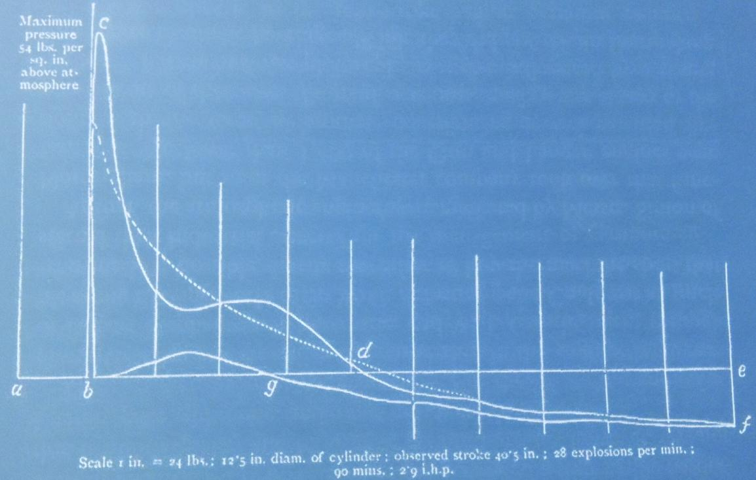
Specifications
Brake horsepower | 2.0
Flywheel rpm | 90
Piston strokes per minute | 30
Cylinder diameter, in. | 12.5
Maximum piston strole, in. | 40.5
Maximum cylinder pressure, psi. | 54
Gas consumption, cubic feet/hour | 36, 42
Mechanical efficiency, % | 68
Thermal efficiency, % | 11.2

Slide 10
Start of a World Industry
2649 Otto and Langen engines was built in Deutz 1864-1885.
Patents licensed to :
  England
  France
  Central Europe
  USA
In total, close to 5000 engines was built.

Slide 11
Contemporary Competitors
Drawbacks, Otto and Langen engine: power limitation, weight, noise and recoil effects.
Competitors: improved hot-air engines, compression engines, improved atmospheric engines .
1875: Daimlers second generation atmospheric engine with double-acting piston.
Gilles atmospheric engine, single acting.

